Slide 1
CSD3009 -
DATA STRUCTURES AND ANALYSIS OF ALGORITHMS
DR.S.DEVARAJU

Slide 2
Module 2
Stacks and Queues: Array- 1D and 2D array, Stack - Applications of stack: Expression Evaluation - Conversion of Infix to postfix and prefix expression, Tower of Hanoi. Stack ADT – Array based Stacks, Linked Stacks – Implementing Recursion using Stacks, Queues – ADT, Array based Queue, Linked Queue, Double ended queue, Circular queue.
https://www.javatpoint.com/data-structure-tutorial

Slide 3
Array

Slide 4
One-Dimensional Array
A linearly organized collection of identical data type elements is referred to as a One-Dimensional (1D) array. A 1D array's items are kept in a single and continuous region in memory, and each element is accessible via its index. An array's initial element always has an index 0, and its last element always has an index n-1, where n is the array's size.
Declaration of One-Dimensional Array
A 1D array can be declared as follows in C:
data_type array_name[array_size];

Slide 5
One-Dimensional Array
For illustration, the following sentence can be used to declare an integer array with a size of 5.
int arr[5];
After an array is declared, we can use the index notation to access its elements:
arr[0] = 1; // Assign 1 to the first element
arr[1] = 2; // Assign 2 to the second element

Slide 6
One-Dimensional Array
Advantages
They are easy to learn and use.
Comparatively speaking, they need less memory than 2D arrays.
They can be accessed more quickly because only one index is needed.
Disadvantages
They cannot accurately represent intricate data structures.
In the case of larger datasets, they can be challenging to read and analyze.

Slide 7
Two-Dimensional Array
A 2D array is a group of identical data-type components arranged in a grid-like pattern. Essentially, it is an array of arrays, where each array corresponds to a grid row. A 2D array's items are kept in a single and continuous area in memory, and each one may be reached using its row and column indices. The row number is represented by the first index, and the column number is represented by the second index.
Declaration of Two-Dimensional Arrays
A 2D array can be declared as follows in C:
data_type array_name[row_size][column_size];

Slide 8
Two-Dimensional Array
For instance, the following sentence can be used to declare a 2D integer array with the dimension 3x3.
int arr[3][3];
The row and column index notation is used to access the elements of a 2D array once it has been declared:
    arr[0][0] = 1; // At row 0 and column 0
    arr[1][2] = 3; // At row 1 and column 2

Slide 9
Two-Dimensional Array
Advantages
They can represent complex data structures like matrices and tables.
They offer an effective method for grid-like data storage and manipulation.
For larger datasets, they can be quickly visualized and analyzed.
Disadvantages
When compared to 1D arrays, they require more memory.
They require two indices, so accessing takes longer.

Slide 10
1D and 2D arrays have different properties
main differences between one-dimensional and two-dimensional arrays are as follows:
1. Syntax:
In C, there are differences in the syntax for declaring and accessing the elements of 1D and 2D arrays. When accessing the elements of a 1D array, we use a single index, whereas when accessing the elements of a 2D array, we use two indices.
2. Memory:
As 1D arrays store elements linearly as opposed to 2D arrays, they use less memory. However, as 2D arrays store data in a grid-like format, where each row is saved as a separate 1D array, they demand more memory.

Slide 11
1D and 2D arrays have different properties
3. Access time:
Because a 1D array only requires one index to reach an element, it can be accessed more quickly than a 2D array. In comparison, using 2D arrays requires two indices, which could slow down the procedure.
4. Complexity:
2D arrays can be more challenging, especially for beginners. In contrast, 1D array are easier to use and comprehend. Understanding row and column indices is necessary for using 2D arrays which can be difficult to grasp at first.

Slide 12
Stack

Slide 13
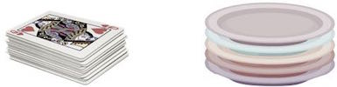
Basic Idea
A stack is an Abstract Data Type (ADT), commonly used in most programming languages. It is named stack as it behaves like a real-world stack, for example – a deck of cards or a pile of plates, etc.

Slide 14
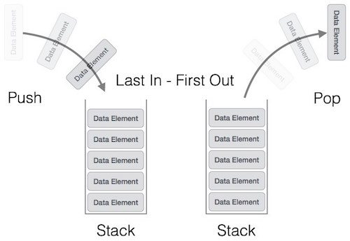
Stack Representation
Can be implemented by means of Array, Structure, Pointers and Linked List.
Stack can either be a fixed size or dynamic.

Slide 15
push
STACK
pop
create
isempty
isfull

Slide 16
STACK: Last-In-First-Out (LIFO)
void push (stack *s, int element);
/* Insert an element in the stack */
int pop (stack *s);
/* Remove and return the top element */
void create (stack *s);
/* Create a new stack */
int isempty (stack *s);
/* Check if stack is empty */
int isfull (stack *s);
/* Check if stack is full */
Assumption: stack contains integer elements!

Slide 17
Stack using Array

Slide 18

PUSH
top
top

Slide 19

POP
top
top

Slide 20


Slide 21

PUSH OPERATION
top

Slide 22

POP OPERATION
top

Slide 23

In the array implementation, we would:
  Declare an array of fixed size (which determines the maximum size of the stack).
  Keep a variable which always points to the “top” of the stack.
    Contains the array index of the “top” element.
In the linked list implementation, we would:
  Maintain the stack as a linked list.
  A pointer variable top points to the start of the list.
  The first element of the linked list is considered as the stack top.

Slide 24

#define MAXSIZE 100
struct lifo
{
int st[MAXSIZE];
int top;
};
typedef struct lifo
stack;
stack s;
struct lifo
{
int value;
struct lifo *next;
};
typedef struct lifo
stack;
stack *top;
ARRAY
LINKED LIST

Slide 25

void create (stack *s)
{
s->top = -1;
/* s->top points to
last element
pushed in;
initially -1 */
}
void create (stack **top)
{
*top = NULL;
/* top points to NULL,
indicating empty
stack */
}
ARRAY
LINKED LIST

Slide 26

void push (stack *s, int element)
{
if (s->top == (MAXSIZE-1))
{
printf (“\n Stack overflow”);
exit(-1);
}
else
{
s->top++;
s->st[s->top] = element;
}
}
void push (stack **top, int element)
{
stack *new;
new = (stack *)malloc (sizeof(stack));
if (new == NULL)
{
printf (“\n Stack is full”);
exit(-1);
}
new->value = element;
new->next = *top;
*top = new;
}
ARRAY
LINKED LIST

Slide 27

int pop (stack **top)
{
int t;
stack *p;
if (*top == NULL)
{
printf (“\n Stack is empty”);
exit(-1);
}
else
{
t = (*top)->value;
p = *top;
*top = (*top)->next;
free (p);
return t;
}
}
int pop (stack *s)
{
if (s->top == -1)
{
printf (“\n Stack underflow”);
exit(-1);
}
else
{
return (s->st[s->top--]);
}
}
ARRAY
LINKED LIST

Slide 28

int isempty (stack *s)
{
if (s->top == -1)
return 1;
else
return (0);
}
int isempty (stack *top)
{
if (top == NULL)
return (1);
else
return (0);
}
ARRAY
LINKED LIST

Slide 29

int isempty (stack *s)
{
if (s->top == -1)
return 1;
else
return (0);
}
int isempty (stack *top)
{
if (top == NULL)
return (1);
else
return (0);
}
ARRAY
LINKED LIST

Slide 30

main() {
stack A, B;
create(&A);
create(&B);
push(&A,10);
push(&A,20);
push(&A,30);
push(&B,100);
push(&B,5);
printf (“%d %d”, pop(&A), pop(&B));
push (&A, pop(&B));
if (isempty(&B))
printf (“\n B is empty”);
return;
}
#include <stdio.h>
#define MAXSIZE 100
struct lifo
{
int st[MAXSIZE];
int top;
};
typedef struct lifo stack;

Slide 31

#include <stdio.h>
struct lifo
{
int value;
struct lifo *next;
};
typedef struct lifo stack;
main() {
stack *A, *B;
create(&A);
create(&B);
push(&A,10);
push(&A,20);
push(&A,30);
push(&B,100);
push(&B,5);
printf (“%d %d”, pop(&A), pop(&B));
push (&A, pop(&B));
if (isempty(B))
printf (“\n B is empty”);
return;
}

Slide 32

Direct applications:
  Page-visited history in a Web browser
  Undo sequence in a text editor
  Chain of method calls in the Java Virtual Machine
  Validate XML
Indirect applications:
  Auxiliary data structure for algorithms
  Component of other data structures

Slide 33
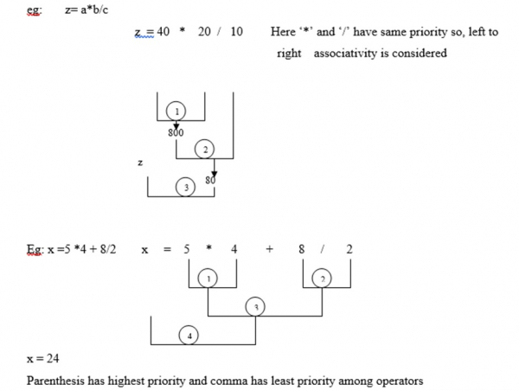
Expression Evaluation
Expressions are evaluated by the ‘C’ compiler based on precedence and associativity rules.
If an expression contains different priority operators, then the precedence rules are considered.

Slide 34
Expression Evaluation
Operators | Symbols
Parenthesis | ( ), {}, [ ]
Exponents | ^
Multiplication and Division | *, /
Addition and Subtraction | + , -

Slide 35
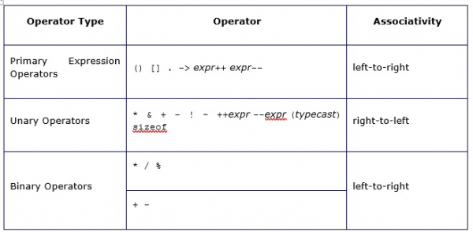
Expression Evaluation

Slide 36
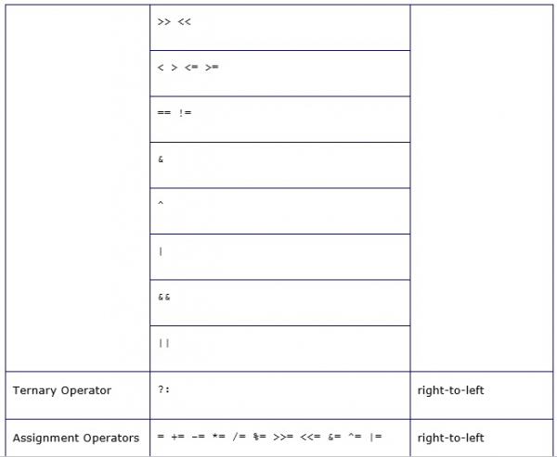
Expression Evaluation

Slide 37

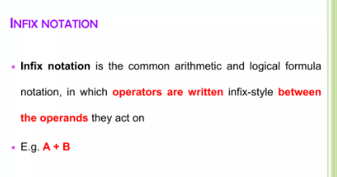
<operand> <operator> <operand>

Slide 38
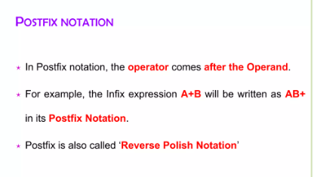
<operand> <operand> <operator>

Slide 39
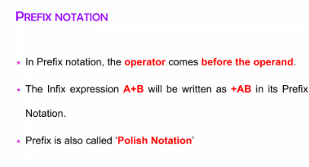
<operator> <operand> <operand>

Slide 40
Infix: operators placed between operands:
A+B*C
Postfix: operands appear before their operators:-
ABC*+
Prefix: operands appear after their operators:-
+A*BC
There are no precedence rules to learn in postfix notation, and parentheses are never needed
Infix Expression | Prefix Expression | Postfix Expression
A + B | + A B | A B +
A + B * C | + A * B C | A B C * +

Slide 41
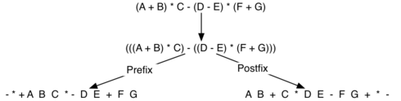
Infix, Prefix and Postfix Expressions
Infix Expression | Prefix Expression | Postfix Expression
(A + B) * C | * + A B C | A B + C *
A + B * C + D | + + A * B C D | A B C * + D +
(A + B) * (C + D) | * + A B + C D | A B + C D + *
A * B + C * D | + * A B * C D | A B * C D * +
A + B + C + D | + + + A B C D | A B + C + D +
Converting a Complex Expression to Prefix and Postfix Notations

Slide 42

Infix | Postfix
A + B | A B +
A + B * C | A B C * +
(A + B) * C | A B + C *
A + B * C + D | A B C * + D +
(A + B) * (C + D) | A B + C D + *
A * B + C * D | A B * C D * +
A + B * C → (A + (B * C)) → (A + (B C *) ) → A B C * +
A + B * C + D → ((A + (B * C)) + D ) → ((A + (B C*) )+ D) →
((A B C *+) + D) → A B C * + D +

Slide 43

Use a stack for processing operators (push and pop operations).
Scan the sequence of operators and operands from left to right and perform one of the following:
  output the operand,
  push an operator of higher precedence,
  pop an operator and output, till the stack top contains operator of a lower precedence and push the present operator.

Slide 44

Print operands as they arrive.
If the stack is empty or contains a left parenthesis on top, push the incoming operator onto the stack.
If the incoming symbol is a left parenthesis, push it on the stack.
If the incoming symbol is a right parenthesis, pop the stack and print the operators until you see a left parenthesis. Discard the pair of parentheses.
If the incoming symbol has higher precedence than the top of the stack, push it on the stack.

Slide 45
If the incoming symbol has equal precedence with the top of the stack, use association. If the association is left to right, pop and print the top of the stack and then push the incoming operator. If the association is right to left, push the incoming operator.
If the incoming symbol has lower precedence than the symbol on the top of the stack, pop the stack and print the top operator. Then test the incoming operator against the new top of stack.
At the end of the expression, pop and print all operators on the stack. (No parentheses should remain.)

Slide 46

First, reverse the infix expression given in the problem.
Scan the expression from left to right.
Whenever the operands arrive, print them.
If the operator arrives and the stack is found to be empty, then simply push the operator into the stack.
If the incoming operator has higher precedence than the TOP of the stack, push the incoming operator into the stack.
If the incoming operator has the same precedence with a TOP of the stack, push the incoming operator into the stack.
If the incoming operator has lower precedence than the TOP of the stack, pop, and print the top of the stack. Test the incoming operator against the top of the stack again and pop the operator from the stack till it finds the operator of a lower precedence or same precedence.

Slide 47
If the incoming operator has the same precedence with the top of the stack and the incoming operator is ^, then pop the top of the stack till the condition is true. If the condition is not true, push the ^ operator.
When we reach the end of the expression, pop, and print all the operators from the top of the stack.
If the operator is ')', then push it into the stack.
If the operator is '(', then pop all the operators from the stack till it finds ) opening bracket in the stack.
If the top of the stack is ')', push the operator on the stack.
At the end, reverse the output.

Slide 48

Requires operator precedence information
Operands:
Add to postfix expression.
Close parenthesis:
pop stack symbols until an open parenthesis appears.
Operators:
Pop all stack symbols until a symbol of lower precedence appears. Then push the operator.
End of input:
Pop all remaining stack symbols and add to the expression.

Slide 49

 | Current symbol | Operator Stack | Postfix string
1 | A |  | A
2 | * | * | A
3 | ( | * ( | A
4 | B | * ( | A B
5 | + | * ( + | A B
6 | C | * ( + | A B C
7 | * | * ( + * | A B C
8 | D | * ( + * | A B C D
9 | ) | * | A B C D * +
10 | + | + | A B C D * + *
11 | E | + | A B C D * + * E
12 |  |  | A B C D * + * E +
Expression:
A * (B + C * D) + E
becomes
A B C D * + * E +
Postfix notation is also called as Reverse Polish Notation (RPN)

Slide 50
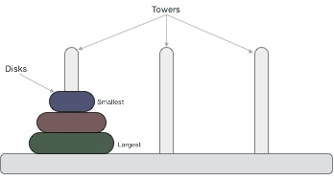
Tower of Hanoi
Tower of Hanoi, is a mathematical puzzle which consists of three towers (pegs) and more than one rings is as depicted −
These rings are of different sizes and stacked upon in an ascending order, i.e. the smaller one sits over the larger one. There are other variations of the puzzle where the number of disks increase, but the tower count remains the same.

Slide 51
Tower of Hanoi
Rules
The mission is to move all the disks to some another tower without violating the sequence of arrangement. A few rules to be followed for Tower of Hanoi are −
  Only one disk can be moved among the towers at any given time.
  Only the "top" disk can be removed.
  No large disk can sit over a small disk.
Following is an animated representation of solving a Tower of Hanoi puzzle with three disks.
Tower of Hanoi puzzle with n disks can be solved in minimum 2^{n}−1 steps. This presentation shows that a puzzle with 3 disks has taken 23 - 1 = 7 steps.

Slide 52
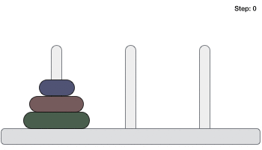
Tower of Hanoi

Slide 53
Tower of Hanoi
Algorithm
To write an algorithm for Tower of Hanoi, first we need to learn how to solve this problem with lesser amount of disks, say → 1 or 2. We mark three towers with name, source, destination and aux (only to help moving the disks). If we have only one disk, then it can easily be moved from source to destination peg.
If we have 2 disks −
First, we move the smaller (top) disk to aux peg.
Then, we move the larger (bottom) disk to destination peg.
And finally, we move the smaller disk from aux to destination peg.

Slide 54
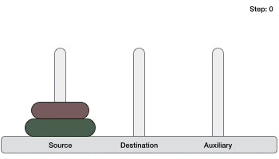
Tower of Hanoi
So now, we are in a position to design an algorithm for Tower of Hanoi with more than two disks. We divide the stack of disks in two parts. The largest disk (n^{th} disk) is in one part and all other (n-1) disks are in the second part.

Slide 55
Tower of Hanoi
Our ultimate aim is to move disk n from source to destination and then put all other (n1) disks onto it. We can imagine to apply the same in a recursive way for all given set of disks.
The steps to follow are −
Step 1 − Move n-1 disks from source to aux
Step 2 − Move nth disk from source to dest
Step 3 − Move n-1 disks from aux to dest

Slide 56
Tower of Hanoi
A recursive algorithm for Tower of Hanoi can be driven as follows −
START
Procedure Hanoi(disk, source, dest, aux)
IF disk == 1, THEN
move disk from source to dest
ELSE
Hanoi(disk - 1, source, aux, dest) // Step 1
move disk from source to dest // Step 2
Hanoi(disk - 1, aux, dest, source) // Step 3
END IF
END Procedure
STOP

Slide 57

Stack ADT
In Stack ADT Implementation instead of data being stored in each node, the pointer to data is stored. The program allocates memory for the data and address is passed to the stack ADT. The head node and the data nodes are encapsulated in the ADT. The calling function can only see the pointer to the stack. The stack head structure also contains a pointer to top and count of number of entries currently in stack.
  push() – Insert an element at one end of the stack called top.
  pop() – Remove and return the element at the top of the stack, if it is not empty.
  peek() – Return the element at the top of the stack without removing it, if the stack is not empty.
  size() – Return the number of elements in the stack.
  isEmpty() – Return true if the stack is empty, otherwise return false.
  isFull() – Return true if the stack is full, otherwise return false.

Slide 58
Array-based Stack
A simple way of implementing the Stack ADT uses an array
We add elements from left to right
A variable keeps track of the index of the top element
Algorithm size()
return t + 1
Algorithm pop()
if empty() then
throw EmptyStackException
else
t = t - 1
return S[t + 1]
…
S
0
1
2
t

Slide 59
Array-based Stack (cont.)
The array storing the stack elements may become full
A push operation will then throw a FullStackException
  Limitation of the array-based implementation
  Not intrinsic to the Stack ADT
Algorithm push(o)
if t = S.length - 1 then
throw FullStackException
else
t = t + 1
S[t] = o
…
S
0
1
2
t

Slide 60
Performance and Limitations
- array-based implementation of stack ADT
Performance
  Let n be the number of elements in the stack
  The space used is O(n)
  Each operation runs in time O(1)
Limitations
  The maximum size of the stack must be defined a priori , and cannot be changed
  Trying to push a new element into a full stack causes an implementation-specific exception

Slide 61
Array-based Stack in C++
template <typename Object>
class ArrayStack {
private:
int capacity; // stack capacity
Object *S; // stack array
int top; // top of stack
public:
ArrayStack(int c) {
capacity = c;
S = new Object[capacity];
t = –1;
}
bool isEmpty()
{ return (t < 0); }
Object pop()
{
if(isEmpty())
throw EmptyStackException
(“Access to empty stack”);
return S[t--];
}
// … (other functions omitted)

Slide 62
Singly Linked List
A singly linked list is a concrete data structure consisting of a sequence of nodes
Each node stores
  element
  link to the next node
next
elem
node
∅
A
B
C
D

Slide 63




Stack with a Singly Linked List
We can implement a stack with a singly linked list
The top element is stored at the first node of the list
The space used is O(n) and each operation of the Stack ADT takes O(1) time
nodes
t
∅
top
elements

Slide 64
Recursion Using Stacks

Slide 65
What’s Going On?
int main() {
// Get Input
int x, y;
cout << "Enter value x: ";
cin >> x;
// Call f
y = f(x);
// Print results
cout << y << endl;
return 0;
}
#include <iostream>
using namespace std;
int f(int n) {
int k, r;
if (n == 0)
return 0; // 0
k = n*n; // 1
r = // 2
f(n - 1); // 3
return k + r; // 4
}

Slide 66
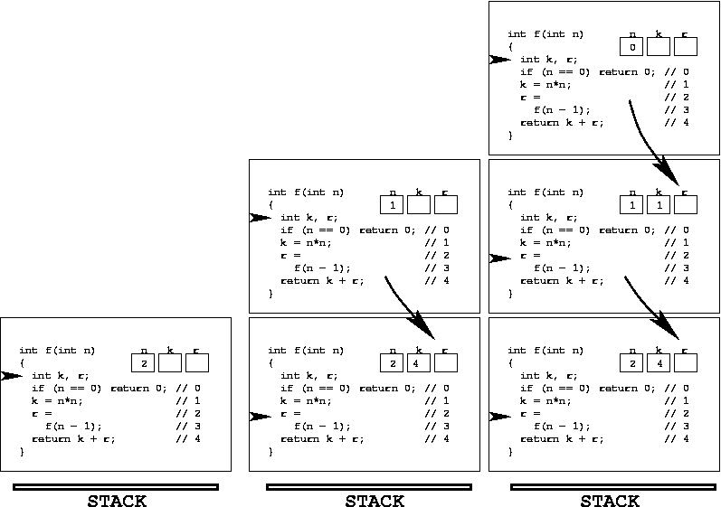
What’s Going On…

Slide 67
Loop
Then loop as long as there are activation records on stack
At each iteration of loop we simulate execution of next line of activation record on top of stack

Slide 68


Slide 69

Basic Idea
Queue is an abstract data structure, somewhat similar to Stacks. Unlike stacks, a queue is open at both its ends. One end is always used to insert data (enqueue) and the other is used to remove data (dequeue).

Slide 70
Definition of a Queue
A queue is a data structure that models/enforces the first-come first-serve order, or equivalently the first-in first-out (FIFO) order.
That is, the element that is inserted first into the queue will be the element that will deleted first, and the element that is inserted last is deleted last.
A waiting line is a good real-life example of a queue. (In fact, the Britich word for “line” is “queue”.)

Slide 71
A Graphic Model of a Queue
Head:
All items are
deleted from
this end
Tail:
All new items
are added on
this end

Slide 72
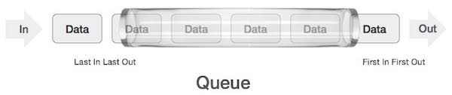
Queue Representation
As in stacks, a queue can also be implemented using Arrays, Linked-lists, Pointers and Structures.

Slide 73
Operations on Queues
Insert(item): (also called enqueue)
  It adds a new item to the tail of the queue
Remove( ): (also called delete or dequeue)
  It deletes the head item of the queue, and returns to the caller. If the queue is already empty, this operation returns NULL
getHead( ):
  Returns the value in the head element of the queue
getTail( ):
  Returns the value in the tail element of the queue
isEmpty( )
  Returns true if the queue has no items
size( )
  Returns the number of items in the queue

Slide 74
Examples of Queues
An electronic mailbox is a queue
  The ordering is chronological (by arrival time)
A waiting line in a store, at a service counter, on a one-lane road
Equal-priority processes waiting to run on a processor in a computer system

Slide 75
enqueue
QUEUE
dequeue
create
isempty
size

Slide 76

void enqueue (queue *q, int element);
/* Insert an element in the queue */
int dequeue (queue *q);
/* Remove an element from the queue */
queue *create();
/* Create a new queue */
int isempty (queue *q);
/* Check if queue is empty */
int size (queue *q);
/* Return the no. of elements in queue */
Assumption: queue contains integer elements!

Slide 77

Queue ADT
The queue abstract data type (ADT) follows the basic design of the stack abstract data type. Each node contains a void pointer to the data and the link pointer to the next element in the queue. The program’s responsibility is to allocate memory for storing the data.
  enqueue() – Insert an element at the end of the queue.
  dequeue() – Remove and return the first element of the queue, if the queue is not empty.
  peek() – Return the element of the queue without removing it, if the queue is not empty.
  size() – Return the number of elements in the queue.
  isEmpty() – Return true if the queue is empty, otherwise return false.
  isFull() – Return true if the queue is full, otherwise return false.

Slide 78


Slide 79
Basic idea:
  Create a linked list to which items would be added to one end and deleted from the other end.
  Two pointers will be maintained:
    One pointing to the beginning of the list (point from where elements will be deleted).
    Another pointing to the end of the list (point where new elements will be inserted).
Rear
Front
DELETION
INSERTION

Slide 80

ENQUEUE
front
rear

Slide 81
DEQUEUE
front
rear

Slide 82

struct qnode
{
int val;
struct qnode *next;
};
struct queue
{
struct qnode *qfront, *qrear;
};
typedef struct queue QUEUE;
void enqueue (QUEUE *q,int element)
{
struct qnode *q1;
q1=(struct qnode *)malloc(sizeof(struct qnode));
q1->val= element;
q1->next=q->qfront;
q->qfront=q1;
}

Slide 83
int size (queue *q)
{
queue *q1;
int count=0;
q1=q;
while(q1!=NULL)
{
q1=q1->next;
count++;
}
return count;
}
int dequeue (queue *q)
{
int val;
queue *q1,*prev;
q1=q;
while(q1->next!=NULL)
{
prev=q1;
q1=q1->next;
}
val=q1->val;
prev->next=NULL;
free(q1);
return (val);
}
int peek (queue *q)
{
queue *q1;
q1=q;
while(q1->next!=NULL)
q1=q1->next;
return (q1->val);
}

Slide 84

The size of the queue depends on the number and order of enqueue and dequeue.
It may be situation where memory is available but enqueue is not possible.
ENQUEUE
DEQUEUE
Effective queuing storage area of array gets reduced.
0
N
front
front
rear
rear
Use of circular array indexing

Slide 85

Direct applications:-
  Waiting lists
  Access to shared resources (e.g., printer)
  Multiprogramming
Indirect applications:-
  Auxiliary data structure for algorithms
  Component of other data structures

Slide 86
Queue as a Class
Much like stacks and linked lists were designed and implemented as classes, a queue can be conveniently packaged as a class
It seems natural to think of a queue as similar to a linked list, but with more basic operations, to enforce the FIFO order of insertion and deletion

Slide 87
A Rough Class for Queue
class Queue{
public:
typedef int datatype; // datatype is the type of items to be
//added to the queue. By changing int to some other // type, the
// queue is easily changed to handle other data types
Queue( );
void enqueue(datatype x);
datatype dequeue( );
datatype peekHead( );
datatype peekTail( );
int size( );
bool isEmpty( );
private:
//A container for items. It’s determined in the implementation
};

Slide 88
A Class for Queue: A Linked List Implementation
class Queue{
public:
typedef int datatype;
Queue( ) { };
void enqueue(datatype x) {q.insertTail(x);};
datatype peekHead( ) {assert(size()>0); q.getHead( )->getData( );};
datatype peekTail( ) {assert(size()>0); q.getTail( )->getData( );};
datatype dequeue( ) {assert(size()>0); int x=peekHead( ); q.removeHead( ); return x;};
int size( ) {return q.size( );};
bool isEmpty( ) {return q.isEmpty( );};
private:
List q;
}; // Time: All member functions take O(1) time.

Slide 89
A Dynamic-Array Implementation of the Queue Class
The container for items is a dynamic array
It is accomplished as:
datatype *p=new datatype[50];

Slide 90
A Class for Queue using Dynamic Arrays
class Queue{
public:
typedef int datatype;
Queue(int capacity = 50) ;
void enqueue(datatype x); datatype dequeue( );
datatype peekHead( ); datatype peekTail( );
int size( ); bool isEmpty( );
private:
int capacity; // default value is 50
datatype *p; // pointer a dynamic array created by constructor
int length; // number of actual elements in the queue
int head; // index of the head element in the array
int tail; // index of the tail element in the array
};

Slide 91
How head and tail Change
head increases by 1 after each dequeue( )
tail increases by 1 after each enqueue( )
tail
head
Now:
49
48
47
4
3
2
1
0
tail
head
After enqueue:
49
48
47
4
3
2
1
0
tail
head
After dequeue:
49
48
47
4
3
2
1
0

Slide 92
False-Overflow Issue First
Suppose 50 calls to enqueue have been made, so now the queue array is full
Assume 4 calls to dequeue( ) are made
Assume a call to enqueue( ) is made now. The tail part seems to have no space, but the front has 4 unused spaces; if never used, they are wasted.
49
48
47
4
3
2
1
0
49
48
47
4
3
2
1
0

Slide 93
Solution: A Circular Queue
Allow the head (and the tail) to be moving targets
When the tail end fills up and front part of the array has empty slots, new insertions should go into the front end
Next insertion goes into slot 0, and tail tracks it. The insertion after that goes into a lot 1, etc.
tail
head
49
48
47
4
3
2
1
0

Slide 94
Illustration of Circular Queues
Current state:
After One Call to enqueue()
After One Call to enqueue()
head
49
48
47
4
3
2
1
0
tail
head
tail
49
48
47
4
3
2
1
0
head
tail
49
48
47
4
3
2
1
0

Slide 95
Numerics for Circular Queues
head increases by (1 modulo capacity) after each dequeue( ):
head = (head +1) % capacity;
tail increases by (1 modulo capacity) after each enqueue( ):
tail = (tail +1) % capacity;

Slide 96
Complete Implementation of Queues with Dynamic Arrays
Show the class structure as a refresher (next slide)
The implementations of the constructor and member functions will follow afterwards

Slide 97
The Class Structure (revisited)
class Queue{
public:
typedef int datatype;
Queue(int capacity = 50) ;
void enqueue(datatype x); datatype dequeue( );
datatype peekHead( ); datatype peekTail( );
int size( ); bool isEmpty( );
private:
int capacity; // default value is 50
datatype *p; // pointer a dynamic array created by constructor
int length; // number of actual elements in the queue
int head; // index of the head element in the array
int tail; // index of the tail element in the array
};

Slide 98
Implementations of the Members
Queue::Queue(int capacity){
this.capacity = capacity;
p = new datatype[capacity];
length=0; head=0; tail=0;
};
int Queue::size( ){return length;};
bool Queue::isEmpty( ) {return (length==0);};
Queue::datatype Queue::peekHead( ){assert(length>0);return p[head];};
Queue::datatype Queue::peekTail( ){assert(length>0); return p[tail];};
Time: All O(1) time.

Slide 99
Implementation enqueue( )
void Queue::enqueue(datatype x){
if (length==0) {p[tail]=x; length++;}
else if (length<capacity) {length++; tail=tail+1 % capacity; p[tail]=x; }
else {// Filled. Create a new array twice big. Copy current array to it. Add x.
datatype *q= new datatype[2*capacity];
int j = head; // copy filled array p (from head to tail) to array q[0…]
for (int i=0;i<capacity;i++) {q[i]=p[j]; j=j+1 % capacity;}
head = 0;
tail = capacity; // pointing to the first empty slot for now
q[tail]=x; // put x in the first empty slot
length++; // account for adding x
capacity = 2*capacity; // reflect that capacity is now doubled
delete [] p; // deletes the old array pointed to by p
p =q; // makes p point to the new array.
}
};
Time: O(1) except at overflow, in which case O(length).

Slide 100
Implementation dequeue( )
Queue::datatype Queue::dequeue( ){
assert(length>0);
datatype x= p[head];
head=head+1 % capacity;
return x;
};
Time: O(1).

Slide 101
END

